Slide 1
Bridging the middle zone: physics-framed matrices for coupled states of energized molecules
COUPLED POTENTIAL ENERGY SURFACES · MACHINE LEARNING
From H₃ and water toward the Criegee intermediate CH₂OO
Jonathan M. Smith, Temple University
SYSTEMS
REFERENCE DATA
CODE
H₃ · H₂O · CH₂OO
FCI · SA-CASSCF
diabml (Python, PyTorch)
ABSTRACT
Energized molecules spend much of their time between bonded and separated, where avoided crossings, ion-pair structures and spin recoupling make a single learned surface inadequate. We combine compatibilization by deep neural network, learning a small Hamiltonian-like matrix whose eigenvalues reproduce ab initio energies, with physics frames built from fragment states: valence-bond structures, diatomics-in-molecules, and charged and excited fragment asymptotes from an electron ladder. The frame fixes symmetry and dissociation limits for any network weights; zero-initialised networks learn only corrections. Tests: H₃, water, and the O–O coordinate of CH₂OO.
Notes:
This talk is about the part of a potential energy surface that hot molecules visit and our models handle worst: between bonded and separated. Plan: what goes on there (crossings, ionic structures, spin recoupling) and why it needs a multistate, diabatic-like description; the line of work from Truhlar and co-workers on diabatic states and learned matrices, ending in CDNN (learn a small matrix and diagonalise it), including how the network works; our own earlier single-surface ML work on hot Criegee intermediates and where it fell short; then the idea added here, building that matrix from physics (fragment states, valence-bond structures, charged and excited fragments) so the network only learns corrections. Tested on H3, H2O and a first look at CH2OO. Everything shown is reproducible with the diabml code base and notebooks.

Slide 2
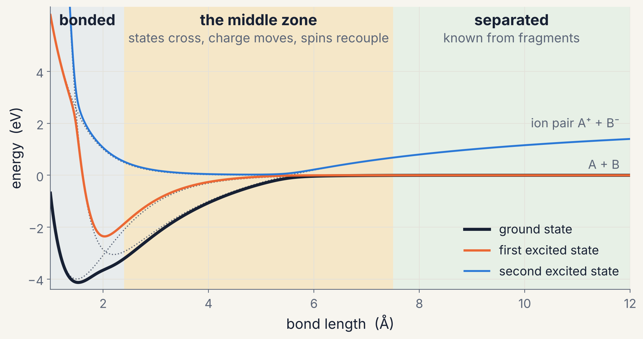
Energized molecules sample the middle zone
INTRODUCTION · THE PROBLEM
Excess energy: chemical activation (ozonolysis), photoexcitation, radical–radical recombination.
Where trajectories go: long excursions between bonded and separated, roughly 1.3–3 × rₑ.
What changes there: several states lie within a few tenths of an eV; character switches between covalent, ionic and biradical.
Data: equilibrium and asymptotes are easy to sample; the middle zone is where data are thinnest and models least constrained.
Schematic three-structure model: Morse bound state, repulsive covalent state, Born–Mayer ion pair with −14.40/r attraction; adiabatic curves are its eigenvalues
2
Notes:
Energized species: chemically activated adducts (e.g. Criegee intermediates born from ozonolysis carry large excess energy), photoexcited molecules, products of radical-radical recombination. Their trajectories spend long stretches where bonds are partially formed. Equilibrium regions are easy to sample and fit; the separated limit is known exactly from fragment calculations. The middle zone, roughly 1.3 to 3 times an equilibrium bond length, is where electronic structure changes character: closed-shell to biradical, covalent to ionic, singlet-coupled to triplet-coupled. That is where a model must be most careful and where data are thinnest. The schematic is a three-structure model (Morse bound state, repulsive covalent state, Born-Mayer ion pair with -14.4/r Coulomb attraction) with couplings that decay exponentially; the adiabatic curves are its eigenvalues.

Slide 3
Diabatic states and learned matrices: the Truhlar line of work
BACKGROUND · PRIOR WORK
Year | Contribution | Key reference
1982 | Strictly diabatic states do not exist in general; work with quasidiabatic states | Mead & Truhlar, JCP 77, 6090
2016–18 | Configuration-uniformity diabatization: DQΦ, then the N/D method | Hoyer et al., JCP 144, 194101; Varga et al., PCCP 20, 26643
2020–23 | Diabatization by deep neural network (DDNN); permutation restraints; PM-DDNN | Shu & Truhlar, JCTC 16, 6456; Shu et al., JCTC 17, 1106; Akher et al., JPCA 127, 5287
2022 | Review: diabatic states of molecules | Shu et al., JPCA 126, 992
2022–23 | Many-state ozone surfaces: 14 ³A′ O₃; six ⁵A′ O + O₂ | Varga et al., Electron. Struct. 4, 047002; Akher et al., JCTC 19, 4389
2022–24 | Dynamics from adiabatic energies and gradients: curvature-driven surface hopping, Ehrenfest | Shu et al., JCTC 18, 1320; Shu & Truhlar, JCTC 20, 4396
2025 | CDNN: learn any compatible matrix from energies alone; LiH, H₃, six O₃ states | Shu, Varga, Zhang, Meng, Parameswaran, Zhou & Truhlar, JCTC 21, 3342
Where this work builds. CDNN leaves the structure of the matrix to the network. Here the matrix is assembled from fragment states (valence-bond structures, diatomics-in-molecules, charged and excited asymptotes), so symmetry and dissociation limits hold for any weights and the network learns only corrections.
3
Notes:
A short map of the work this talk builds on, all from Truhlar and co-workers (Minnesota). Mead and Truhlar (1982) showed that strictly diabatic states, with vanishing derivative coupling, do not exist in general for polyatomics; practical work uses quasidiabatic states that are smooth and keep their chemical character. The configuration-uniformity methods (fourfold way; DQ-Phi of Hoyer, Parker, Gagliardi and Truhlar 2016; the N/D method of Varga, Parker and Truhlar 2018) construct such states from multireference wavefunctions. Shu and Truhlar (2020) introduced diabatization by deep neural network (DDNN): a network outputs a diabatic matrix whose eigenvalues fit adiabatic energies, with diabatic restraints from prior physical knowledge; later papers added permutational restraints and permutation-invariant inputs (PM-DDNN) and applied this to many-state ozone and O + O2 surfaces. A parallel line developed dynamics methods that need only adiabatic energies and gradients (curvature-driven coherent switching with decay of mixing, Ehrenfest variants). CDNN (2025) drops the diabatic restraints: any matrix whose eigenvalues match (a compatible potential energy matrix) is enough for those dynamics methods. Our step: put physics back into the structure of the matrix itself, not into restraints, by building it from fragment states.

Slide 4
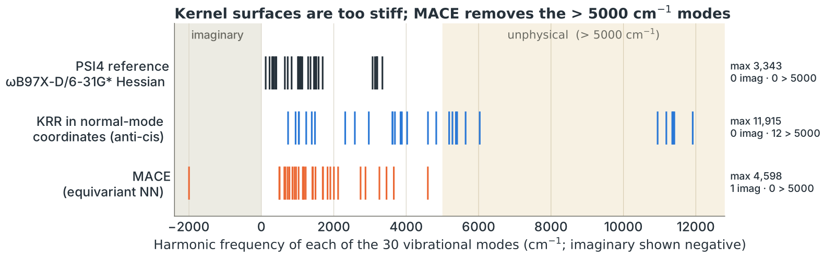
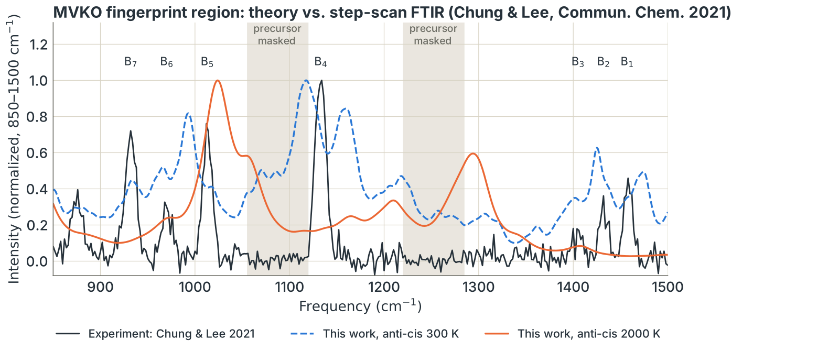
Earlier ML surfaces for hot Criegee intermediates
BACKGROUND · OUR PREVIOUS WORK
WHAT WORKED
MVKO S₀ surface (KRR) from 904 B3LYP/6-31G* frames: 0.27 kcal/mol RMSE; analytic forces, 903× faster than DFT
ML molecular dynamics at 0.5 fs, 300–2000 K; CASSCF Δ-ML corrections near equilibrium (LOO 0.06–0.65 kcal/mol)
Harmonic IR of MVKO within 5–20 cm⁻¹ of the Chung & Lee bands
WHERE IT FELL SHORT
Distorted geometries: single-reference DFT off by 9–21 kcal/mol against NEVPT2
Hot (1000–2000 K) frames: kernel surfaces too stiff (5–12 of 30 modes above 5000 cm⁻¹), imaginary modes; sGDML trajectory dissociated; MACE 11 kcal/mol RMSE
Dipole-ACF IR dominated by torsions; the 2000 K spectrum does not match experiment
One single-reference surface cannot carry the multistate, multireference character of hot, distorted geometries: the middle zone is where these models failed.
Online: talk slides · poster image · poster PDF · laserchemist.github.io/MD_MLPES/talk
Belinta Simiyu & Jonathan M. Smith, ACS Fall 2025 poster (MD_MLPES); experiment: Chung & Lee, Commun. Chem. 4, 8 (2021)
4
Notes:
Our previous effort (Belinta Simiyu and Jonathan M. Smith, ACS Fall 2025 poster; slides and poster online at laserchemist.github.io/MD_MLPES/talk; MD_MLPES repository) built machine-learned single-surface potentials for CH2OO and methyl vinyl ketone oxide (MVKO). It worked near equilibrium: a kernel ridge surface for MVKO from 904 B3LYP/6-31G* frames (normal-mode displacements plus PSI4 MD at 300, 600 and 1000 K) reached 0.27 kcal/mol RMSE with analytic forces about 900 times faster than DFT; ML-MD ran at 0.5 fs from 300 to 2000 K; CASSCF delta-ML corrections near the four conformer minima were accurate to 0.06-0.65 kcal/mol in leave-one-out tests; harmonic dipole-derivative IR of MVKO matched the Chung and Lee (2021) step-scan FTIR bands within 5-20 cm-1, and CH2OO bands appeared at 803 and 1110 cm-1. It failed where this talk is aimed. At distorted geometries the single-reference DFT reference itself was off by 9 to 21 kcal/mol against NEVPT2. Adding adaptive 1000-2000 K frames gave imaginary modes; kernel models became too stiff (5-12 of the 30 harmonic frequencies above 5000 cm-1; sGDML up to 38,342 cm-1) and the sGDML trajectory dissociated, so it was retired; an equivariant MACE model removed the stiff modes but had 11 kcal/mol energy RMSE on the mixed set and one imaginary mode. Dipole autocorrelation IR was dominated by torsions, and the 2000 K spectrum did not reproduce experiment. The lesson: a single adiabatic surface fitted to single-reference data cannot represent the multistate character the molecule reaches when hot.

Slide 5
Three things happen in the middle zone
INTRODUCTION · THE PROBLEM
Avoided crossings
Ionic structures
Spin recoupling
Two states approach and exchange character. The surfaces stay apart but bend sharply, and the derivative coupling peaks.
An ion pair A⁺B⁻ falls as −14.40 eV·Å / r and crosses covalent states near r* ≈ 14.40 / ΔE.
Paired electrons unpair: a singlet bond becomes a biradical, and singlet and triplet fragment channels compete.
The zwitterion H₂C=O⁺–O⁻ in CH₂OO; O⁻H⁺ character in water.
Any bond that can break to more than one set of products.
O(¹D) versus O(³P) products; one-, two- and three-electron H₃.
Each requires more than one electronic state, and the states mix: a multistate description is needed.
5
Notes:
Avoided crossing: for a diatomic, states of the same symmetry cannot cross (von Neumann-Wigner); the adiabatic states exchange character over a region whose width scales with the coupling, and the nonadiabatic coupling peaks there (Landau-Zener for the dynamics). Ionic-covalent crossings are the classic harpoon picture: with dE the energy of the ion pair above the covalent asymptote (IE of the donor minus EA of the acceptor), the Coulomb curve crosses at r* = 14.40/dE in Angstrom. Spin recoupling: breaking a singlet bond produces two doublet radicals whose spins must recouple; multireference character grows, and closed-shell single-reference methods fail qualitatively. In polyatomics, states of the same symmetry can cross along seams of conical intersections.

Slide 6
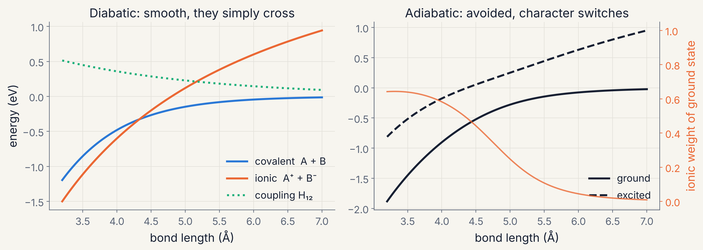
Two representations of the same states
INTRODUCTION · REPRESENTATIONS
Diabatic: states keep their chemical character (covalent, ionic). Matrix elements are smooth; energies are the eigenvalues of a small matrix.
Adiabatic: what quantum chemistry returns. Character switches, curves bend sharply, and derivative couplings become singular at conical intersections.
Two-state model: covalent Morse curve and Born–Mayer/Coulomb ion pair with exponentially decaying coupling
6
Notes:
Adiabatic states diagonalise the electronic Hamiltonian at each geometry. Their nonadiabatic coupling vectors scale like 1/(E_j - E_i) and are singular at conical intersections, and the surfaces have cusps there. A diabatic representation trades this for a smooth Hamiltonian matrix whose off-diagonal elements are the couplings. Strictly diabatic states (zero derivative coupling) do not exist in general for more than a two-state, one-coordinate problem (Mead and Truhlar, J. Chem. Phys. 77, 6090, 1982), so in practice we use quasi-diabatic states: smooth, chemically interpretable, small residual coupling. Classic routes: configuration uniformity (the fourfold way and DQ-Phi of Truhlar and co-workers), property-based (dipole or charge), block diagonalisation. The right panel's orange curve is the ionic weight of the adiabatic ground state in this two-state model: it shows the character change that an adiabatic fit has to reproduce through a sharp bend.

Slide 7
Failure modes of single-surface fits on H₃
LEARNING COUPLED SURFACES · MOTIVATION
Three single-surface failure modes, each measured on H₃ against FCI:
Failure mode | Test | Model result | Exact
Descriptor extrapolation | Kernel ridge on a cutoff radial descriptor, trained without half-broken bonds | −104 kcal/mol well at the collinear saddle | +10.6 kcal/mol barrier
Crossing topology | Two adiabatic states fitted as independent outputs | ≈ 300 meV gap at the conical intersection | 0
Permutation symmetry | Unconstrained matrix model; two identical H atoms relabelled | 0.6–1.1 eV change in energy | 0
Common cause: nothing in the model encodes crossing topology, identical-particle symmetry, or what happens between bonded and separated.
FCI/cc-pVDZ references for H₃; diabml exploratory notebooks
7
Notes:
Three failure modes, each measured on H3 against FCI. (1) Descriptor: a SOAP-like Gaussian radial basis with a smooth cutoff, trained on equilibrium plus dissociated geometries only, turns a half-broken bond into channels it never saw; kernel ridge regression puts a spurious 104 kcal/mol well at the collinear saddle, whose exact barrier is +10.6 kcal/mol above H + H2 at this level. Monotone overlap or Morse-type descriptors interpolate this region well (1-6 kcal/mol). (2) Topology: fitting the two adiabatic states with independent outputs leaves roughly 300 meV of artificial gap at the conical intersection (Shu et al. 2025, Fig. 1b, reproduced here). (3) Symmetry: an unconstrained matrix model of the three distances changes by hundreds of meV to about 1 eV when two identical atoms are swapped, on geometries outside its training distribution.

Slide 8

Compatibilization by deep neural network
LEARNING COUPLED SURFACES · CDNN
Geometry
distances R
Neural network
weights θ
Matrix Ω(R)
n × n, symmetric
Diagonalise
eigvalsh
Energies
E₁(R) … Eₙ(R)
DATA
TOPOLOGY
DEMONSTRATED
Adiabatic energies only. No wavefunctions, couplings or diabatic restraints: the matrix is never told to be diabatic.
Conical intersections and avoided crossings follow from the eigenvalues; no cusps are fitted.
LiH (4 states); H₃ at its conical intersection; six states of O₃ over 11,249 geometries (≈ 20 meV mean error).
Compatible matrix: any smooth real symmetric Ω(R) whose eigenvalues are the adiabatic energies. A diabatic matrix is one special case.
Shu, Varga, Zhang, Meng, Parameswaran, Zhou & Truhlar, J. Chem. Theory Comput. 21, 3342 (2025)
8
Notes:
The paper calls Omega the compatible potential energy matrix (CPEM): any real symmetric matrix function with continuous derivatives whose eigenvalues are the adiabatic energies. A diabatic potential energy matrix is the special case smooth enough that its derivative couplings can be neglected; a CPEM need not be. The cost (their eq. 5) is the mean squared eigenvalue error plus an L2 penalty on the weights. They compare tridiagonal, pentadiagonal and dense CPEMs: all fit equally well (LiH MUEs 25-27 meV; O3 6-state MUEs 19.3-19.9 meV over 11,249 XMS-CASPT2 geometries), but the discovered matrices differ a lot, confirming that many matrices are compatible with the same energies. For H3 they also add a topology-attention term that rewards sign changes of the off-diagonal element (CTAN), nudging the CPEM toward diabatic behaviour. Practical motivation: curvature-driven surface hopping and related methods need only adiabatic energies and gradients, not NACs.

Slide 9
A feed-forward network whose output is a matrix
NETWORK DETAILS · ARCHITECTURE
x ∈ ℝ³
r₁₂, r₁₃, r₂₃
standardised
256
Linear
+ GELU
128
Linear
+ GELU
64
Linear
+ GELU
3
Linear
Ω₁₁ Ω₂₂ Ω₁₂
eigvalsh
λ₁ ≤ λ₂
= E₀, E₁
HIDDEN LAYERS
OUTPUT HEAD
EIGENVALUE LAYER
a⁽ˡ⁺¹⁾ = GELU(W⁽ˡ⁾ a⁽ˡ⁾ + b⁽ˡ⁾)
Linear, no activation. For n states it emits the unique matrix elements: n(n+1)/2 dense, 2n−1 tridiagonal, 3n−3 pentadiagonal.
A parameter-free, differentiable eigenvalue solver. The network never predicts energies directly; it predicts a matrix.
GELU(z) = z · Φ(z)
Φ is the normal CDF: a smooth ReLU, so energies and forces stay continuous.
This H₃ model: 42,371 parameters.
Architecture of Shu et al. (2025) for H₃; GELU: Hendrycks & Gimpel, arXiv:1606.08415
9
Notes:
For computer scientists: this is a plain multilayer perceptron regression model with an unusual output transformation. Inputs are internuclear distances (they are already invariant to rotation and translation; the paper notes permutationally invariant polynomials or equivariant graphs as alternatives). Hidden widths 256-128-64 are the paper's H3 choice (LiH 100-100, O3 1024-512-256-128-64). GELU (Hendrycks and Gimpel 2016) is used because the potential must be smooth: a ReLU network gives piecewise-linear energies and discontinuous forces, which molecular dynamics cannot tolerate. The output layer is linear with n(n+1)/2 units for a dense matrix; these fill the upper triangle of a symmetric matrix. The eigenvalue solver has no parameters; it is a fixed nonlinear map from matrices to sorted eigenvalues. Parameter count for 3-256-128-64-3: 1024 + 32896 + 8256 + 195 = 42,371. Training in the paper: Adam, 300 random restarts, keep the best.

Slide 10
Training through a diagonalisation
NETWORK DETAILS · TRAINING
LOSS: EIGENVALUES AGAINST ENERGIES
L(θ) = 1/(2Nn) Σ_g Σ_k [λ_k(Ω_θ(R_g)) − V_k,g]²
+ (α/2) ‖W‖²
PyTorch, one training step
x = (R - mu) / sd
o = net(x) # (N, 3)
Omega = torch.stack(
[o[:,0], o[:,2], o[:,2], o[:,1]], 1
).view(-1, 2, 2)
lam = torch.linalg.eigvalsh(Omega)
loss = 0.5 * ((lam - V)**2).mean()
loss += 0.5 * alpha * l2(net)
loss.backward() # v vᵀ inside
opt.step() # Adam
EIGENVALUE GRADIENT
∂λ_k / ∂Ω = v_k v_kᵀ
First-order perturbation theory (Hellmann–Feynman for matrices).
No eigenvalue gap in a denominator, so it stays finite at crossings.
Eigenvector derivatives contain 1/(λ_j − λ_k); the loss never uses them.
Loss as in Shu et al. (2025), eq. 5; Adam: Kingma & Ba, arXiv:1412.6980
10
Notes:
Why this works numerically: for a symmetric matrix with eigenpairs (lambda_k, v_k), d lambda_k = v_k^T dOmega v_k. Autograd uses exactly this for eigvalsh. Gradients of eigenvectors involve sums over j of v_j v_j^T / (lambda_k - lambda_j), which blow up at degeneracies; training on eigenvalues only avoids them. At an exact degeneracy the individual eigenvalue gradients depend on an arbitrary basis of the degenerate subspace, but their sum is well defined and data rarely sit exactly on a seam. In diabml the 2x2 case uses the closed form (m +/- sqrt(d^2 + Omega_12^2 + eps)) with eps = 1e-12, which is smooth everywhere. Optimiser: Adam with a cosine learning-rate schedule; several random restarts; the restart and epoch with the lowest validation error are kept (early stopping by checkpoint). The L2 term is the paper's alpha_2 smoothness penalty. Data per geometry: n energies, nothing else.

Slide 11
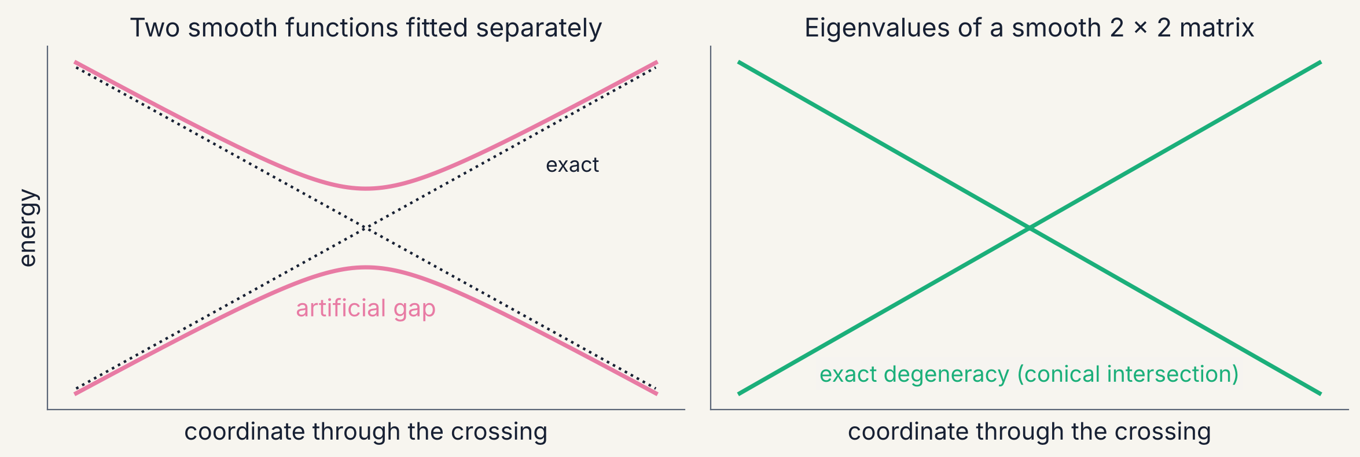
Why the eigenvalue layer gets crossings right
NETWORK DETAILS · TOPOLOGY
E± = m ± √(d² + Ω₁₂²), with m and d the mean and half-difference of the diagonal. The |x|-shaped cusp comes from the square root, so the network itself only has to be smooth.
Degeneracy needs two conditions at once, Ω₁₁ = Ω₂₂ and Ω₁₂ = 0 (von Neumann–Wigner). With two or more coordinates they meet at points or seams: conical intersections.
J. von Neumann & E. Wigner, Phys. Z. 30, 467 (1929)
11
Notes:
This is the key inductive bias of CDNN. A network that outputs E0 and E1 directly is a smooth function; near a conical intersection the true surfaces behave like |x|, which a smooth function can only approximate by rounding the tip, leaving a small artificial gap (or, if pushed, a double crossing). A smooth matrix whose eigenvalues are taken does not have this problem: the non-smoothness is supplied by the square root in the eigenvalue formula. Counting: the set of real symmetric 2x2 matrices with equal eigenvalues has codimension 2, so in a space of N internal coordinates degeneracies of states of the same symmetry form (N-2)-dimensional seams: points in 2D cuts like the paper's H3 example, lines in 3D. For a diatomic (one coordinate) same-symmetry states generically avoid each other: the noncrossing rule. The network still has to learn where both conditions hold simultaneously; it gets the local |x|-shaped topology of the conical intersection for free, not its location.

Slide 12
Building physics in versus hoping it is learned
NETWORK DETAILS · INDUCTIVE BIAS
Property (H₃) | Plain CDNN | + permutation augmentation | Physics frame
Same energy when identical atoms are relabelled | 0.6–1.1 eV off | 26–118 meV off | exact
Degenerate at every equilateral geometry | 0.2–1.6 eV gap | 0.05–0.7 eV gap | exact
Correct dissociation limits | not guaranteed | not guaranteed | exact
Prediction of an untrained model | random | random | the physics prior
Augmentation shows the model every relabelled copy of each geometry. It helps, but symmetry stays approximate and the data grow with the group order (6 for H₃).
Construction makes symmetry hold for any weights, as convolutions do for translations in images and equivariant networks (NequIP, MACE) do for rotations.
Global H₃ surface, 25–200 training geometries; held-out test geometries; FCI/cc-pVDZ
12
Notes:
Numbers from slides/make_figures.py (h3_results.json): mean over two random splits at each training size. Relabelling error = mean absolute change of both energies under the five non-trivial permutations of (r12, r13, r23), on test geometries. Equilateral gap = mean E1 - E0 over nine D3h geometries of the global set, where FCI gives exactly zero. Training recipe shared by all models: inputs standardised; Adam with a cosine learning-rate schedule; 3000 steps; two random restarts; checkpoint with the lowest validation MAE kept. Framed models get one extra trick that matters a lot: the last layer of every correction network is initialised to zero, so at step 0 the model is exactly the physics prior and gradient descent learns a residual (the same idea as residual networks and as delta-learning in quantum chemistry). Augmentation multiplies the training set by the group order (6 for three identical atoms; it grows factorially with more identical atoms, which is why construction scales better).

Slide 13
A physics frame: structures first, corrections second
PHYSICS FRAMES · THE IDEA
Ω(R) = Ω_frame(R; fragment states) + env(R) · NN_θ(x(R))
STRUCTURES
SYMMETRY
LIMITS
Rows and columns are chemical structures (covalent, ionic, biradical), labelled by the fragment states they dissociate to.
Matrix elements transform as the structures do, so degeneracies and permutation invariance hold for any weights.
Fragment energies are exact at dissociation; every learned term is multiplied by an envelope that vanishes there.
Output layers start at zero: an untrained model is the physics prior, and training learns only what the prior misses.
Lineage: London (1929); Sato (1955); Ellison (1963); Warshel & Weiss (1980); Yin et al. (2021)
13
Notes:
This is the idea added to CDNN here. The frame decides which structures span the matrix (how many, and what they are), how its elements behave under symmetry, and its dissociation limits; small networks learn named corrections (slots) inside it. Historical lineage: valence-bond theory, London 1929; LEPS (Sato 1955); diatomics-in-molecules (Ellison 1963), which builds the polyatomic Hamiltonian from diatomic fragment Hamiltonians; empirical valence bond (Warshel and Weiss 1980) and its machine-learned variants. Closely related ML work: Yin, Braams, Fu and Zhang (JCTC 2021) used a valence-bond model to derive how quasidiabatic matrix elements of H3+ transform, and fed symmetry-adapted networks; Allen and Csanyi (JCP 2024) predict EVB parameters from reaction SMILES. Envelope choice matters (see CH2OO): use something that decays like orbital overlap, and network inputs that saturate at long range, so the network cannot extrapolate wildly beyond its data. In diabml a frame is a class with prepare() and assemble(); FramedModel attaches a zero-initialised MLP to each slot.

Slide 14
London, 1929: a reaction is a competition between bonds
PHYSICS FRAMES · BACKGROUND
H–H · · · H
H · · H · · H
H · · · H–H
Before: one full bond, one spectator atom
Halfway: two half-bonds; energy rises: the barrier
After: the bond has moved to the other side
Three electrons can make only one electron-pair bond at a time.
The energy of H₃ is built from pieces measured on H₂, one per pair of atoms: Q, the Coulomb energy, and J, the exchange energy that makes a bond when two electrons pair.
From H₂: bond (singlet) = Q + J; no bond (triplet) = Q − J.
E = Qab + Qbc + Qac
− √½[(Jab−Jbc)² + (Jbc−Jac)²
+ (Jac−Jab)²]
Check: move atom c far away and E becomes the H₂ bond energy, Q + J. The square root is the energy gained when the two bonding pictures mix (resonance).
F. London, Z. Elektrochem. 35, 552 (1929) · W. Heitler & F. London, Z. Phys. 44, 455 (1927) · H. Eyring & M. Polanyi, Z. Phys. Chem. B 12, 279 (1931)
14
Notes:
An undergraduate's route into the next slide. In 1927 Heitler and London explained the H2 bond: two electrons on two protons give a low-energy singlet (spins paired, the bond) and a repulsive triplet (spins parallel, no bond). They wrote the two energies as Q + J and Q - J, where Q is the classical electrostatic energy of the two atoms' charge clouds and J the exchange energy, a purely quantum term that appears because electrons are indistinguishable and can swap places. In 1929 London asked what happens when a third H atom approaches: H + H2 to H2 + H. With three electrons only one pair can bond at a time, so the system is described by two bonding pictures, H(a)-H(b) with H(c) loose, and H(a) loose with H(b)-H(c), which mix. Treating each pair of atoms as if it were an H2 molecule gives the formula on the slide (the London equation). Two checks students can do: (1) with atom c far away, J_bc = J_ac = 0 and the square root is |J_ab|, so E = Q_ab + J_ab (J is negative for a bond), the H2 energy; (2) at the symmetric halfway point, J_ab = J_bc, each bond is only half-formed and the energy is higher than at the start: the activation barrier. Eyring and Polanyi (1931) used this formula with partly empirical Q and J to draw the first potential energy surface for a chemical reaction, which led to transition-state theory. The square root is the lower eigenvalue of a 2 x 2 matrix of the two bonding pictures: the subject of the next slide and the reason this 1929 idea is a physics frame for a learned matrix.

Slide 15
H₃: London’s 1929 matrix is already a compatible matrix
PHYSICS FRAMES · H₃
Exact degeneracy: (a, b) transform as the E irrep of D₃h, so E₀ = E₁ at every equilateral geometry: the conical intersection seam.
Permutation invariance: relabelling the atoms leaves the eigenvalues unchanged.
Limits: one atom far away gives exactly H₂ + H, in both states.
Learned slots: a singlet–triplet (Sato-type) mixing and three-body corrections to Q and J, switched off when any atom leaves.
Ω = (Q₁₂ + Q₁₃ + Q₂₃) 𝟙 + [ a b ; b −a ]
a = J₁₂ − ½ (J₁₃ + J₂₃)
b = (√3 / 2)(J₁₃ − J₂₃)
Q = (¹E + ³E)/2 and J = (¹E − ³E)/2 per pair, from the exact H₂ singlet and triplet curves. No H₃ data.
London (1929); Eyring & Polanyi (1931); S. Sato, J. Chem. Phys. 23, 592 (1955)
15
Notes:
The London equation (London 1929; Eyring and Polanyi 1931) is the lower eigenvalue of this 2x2 matrix in the basis of the two covalent valence-bond structures of three one-electron atoms; the upper eigenvalue is a prediction for the first excited doublet. a and b are the components of the E representation of D3h formed from the three exchange terms, which is why the degeneracy at D3h is exact and why the eigenvalues are permutation invariant (permutations rotate or reflect the (a, b) vector, preserving its length). LEPS (Sato 1955) adds a parameter that mixes singlet and triplet curves. A detail we found while building the frame: classic LEPS applies the Sato parameter everywhere, which keeps the ground-state H2 + H limit exact but scales the triplet curve by (1-d)/(1+d), so the excited state's H2 + H limit is wrong. In diabml the learned Sato function is multiplied by a third-atom proximity factor, so both limits stay exact; a pytest checks this with random weights.

Slide 16
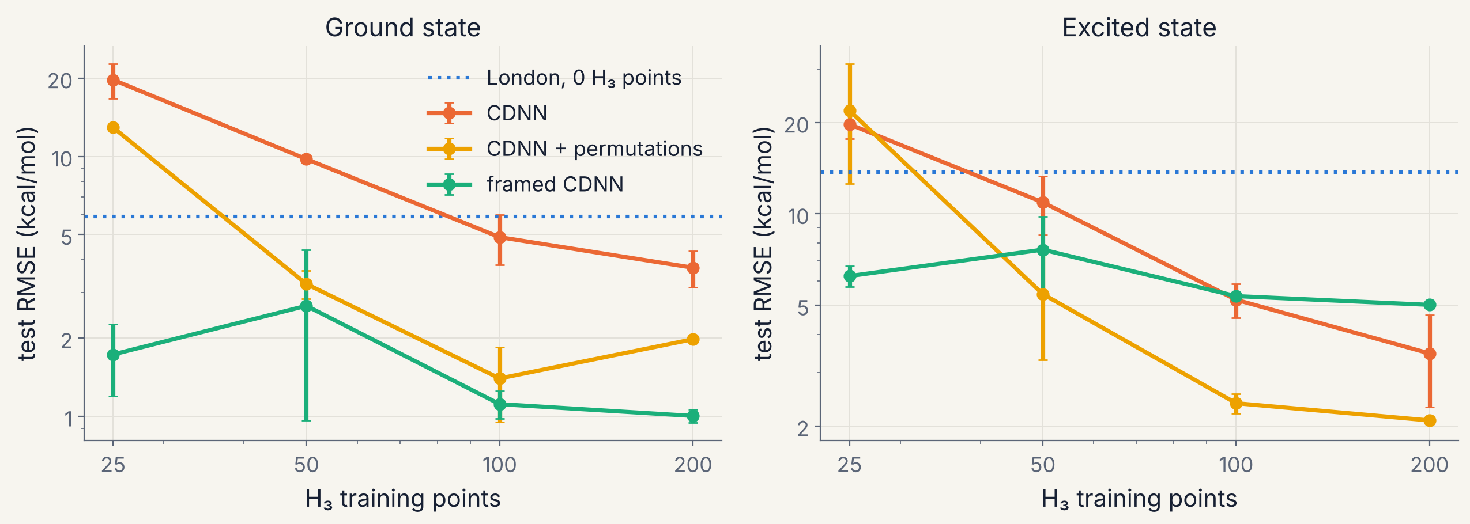
With a frame, 25 points do what 200 cannot without one
PHYSICS FRAMES · H₃ RESULTS
Ground state: 1.7 kcal/mol from 25 points and 1.0 from 200, with exact symmetry. Plain CDNN needs about 100 points to beat London’s 5.9.
Excited state: the frame plateaus near 5 kcal/mol; at compressed geometries S₁ is no longer a covalent-structure state. With enough data, flexible models do better here.
Test RMSE (kcal/mol), mean of two random splits; 499 FCI/cc-pVDZ geometries
16
Notes:
Two random splits per size; bars show the range. Window: every H-H distance at least 0.6 Angstrom and ground state within 5.4 eV of three free atoms (499 FCI geometries; 60 held out for validation). Framed CDNN ground state 1.73, 1.11, 1.0 kcal/mol at 25, 100, 200 points; excited state 6.2, 5.4, 5.0. Plain CDNN 4.9 at 100 and 3.7 at 200; with permutation augmentation 2.0 and 2.1 at 200. The excited-state plateau is diagnostic, not a failure of learning: the worst points are compressed collinear geometries where S1 lies 3.5 to 7 eV above three atoms and is dominated by configurations outside the two covalent structures (ionic H+H-H-type and Rydberg-like character). The frame cannot represent them without more structures, the same lesson water teaches next. For comparison with the earlier exploratory work at the same level: the 6-parameter LEPS Sato(r) model reached 1.8 kcal/mol for the ground state from 20 points and 1.0 from 80; the framed CDNN matches that and adds the excited state and an exact intersection seam.

Slide 17
The ladder: add one electron at a time
THE ELECTRON LADDER · BACKGROUND
Same three H nuclei; one more electron on each rung, one new piece of physics per step:
RESULT
Orbital-level parameters (how fast electrons hop, how strongly they repel) learned on the lower rungs did not predict H₃ well.
Whole fragment states (H₂ bonded and non-bonded) did better, with no H₃ data.
3
H₃ · three electrons
Spins must pair, so only one bond at a time. The target.
2
H₃⁺ · two electrons
For larger molecules the ladder becomes a list of fragment states to compute: neutral, cation, anion, excited.
Electrons repel and pair into one bond shared by three atoms.
CH₂OO: CH₂O, CH₂O⁺, CH₂O(T₁), O(³P), O(¹D), O⁻
H₃²⁺ · one electron
1
The electron hops between atoms; sharing alone lowers the energy.
17
Notes:
A plain-language version of the next slide. The ladder keeps the nuclei the same and adds electrons one at a time, so each step switches on one new piece of physics. Rung 1, H3(2+): a single electron spread over three protons; the only physics is hopping (resonance), and sharing the electron lowers the energy, the simplest kind of chemical bond. Rung 2, H3+: two electrons, which repel each other (what chemists call electron correlation) and pair their spins into a three-centre two-electron bond, the bonding in the H3+ ion found in interstellar space. Rung 3, H3: three electrons; spins must pair, so only one ordinary bond can exist at a time, which is exactly the London picture of the previous slides. The experiment: learn the hopping and repulsion parameters on rungs 1 and 2 (plus H2+ and H2), then predict H3 with no H3 data. It came out 12.6 kcal/mol off, and adding more lower-rung data made it worse, because three-electron spin pairing depends on combinations of those parameters that one- and two-electron systems never test. Using whole fragment states instead, the exact H2 bonded (singlet) and non-bonded (triplet) energies, already contains all of that physics and gave 5.5 kcal/mol with no H3 data. For heavier molecules the ladder turns into a practical list: compute the neutral fragments, their cations and anions (for ionic structures like the CH2OO zwitterion, which separates to CH2O+ and O-) and their excited and spin states (O(1D) versus O(3P), triplet CH2O for the biradical). Those numbers fix where each structure sits when the molecule comes apart.

Slide 18
What transfers from small systems to larger ones?
THE ELECTRON LADDER · H₃
H₃²⁺ · 1 electron
Model of H₃ | H₃ data | RMSE (kcal/mol)
Site Hamiltonian learned on the lower rungs | none | 12.6
… with more lower-rung states added | none | 25.1
London: exact H₂ fragment states | none | 5.5
Same site Hamiltonian fitted to all rungs and H₃ | all | 2.9
hopping between sites
H₃⁺ · 2 electrons
on-site repulsion, three-centre bond
H₃ · 3 electrons
spin recoupling: the target, never trained on
Orbital-level parameters fit every rung but do not determine H₃. Fragment states transfer. The ladder decides which charge and spin states of the fragments the matrix must contain.
Ground-state RMSE against FCI/cc-pVDZ over the H₃ window; exploratory ladder notebook
18
Notes:
The ladder experiment: one orthogonal site orbital per H, an extended Hubbard / DIM-like Hamiltonian whose two-centre functions (hopping, site energies, inter-site Coulomb, exchange, bond-charge terms) are linear combinations of Slater overlaps, with exact asymptotes. Rungs: H2+ and H3(2+) (one electron: hopping), H2 singlet and triplet (two electrons on two centres), H3+ (two electrons on three centres), then H3 (three electrons) predicted with no H3 data. Each rung fits to a few kcal/mol, yet H3 comes out at 12.6 kcal/mol, and adding more lower-rung states (H3+ triplet, H3(2+) excited) made it worse (25.1): the three-electron spin recoupling depends on combinations of terms that one- and two-electron data cannot separate. The functional form itself is fine: one parameter set fitted to all rungs plus H3 gives 2.9. London, built from exact H2 singlet and triplet energies with orbital relaxation and correlation already inside them, reaches 5.5 with no H3 data. Lesson: transfer fragment-state energies, not orbital integrals. Recast for heavier atoms: compute the ladder of charged and excited fragment states (cations, anions, triplets, excited terms) because those are the structures and asymptotes a frame needs.

Slide 19
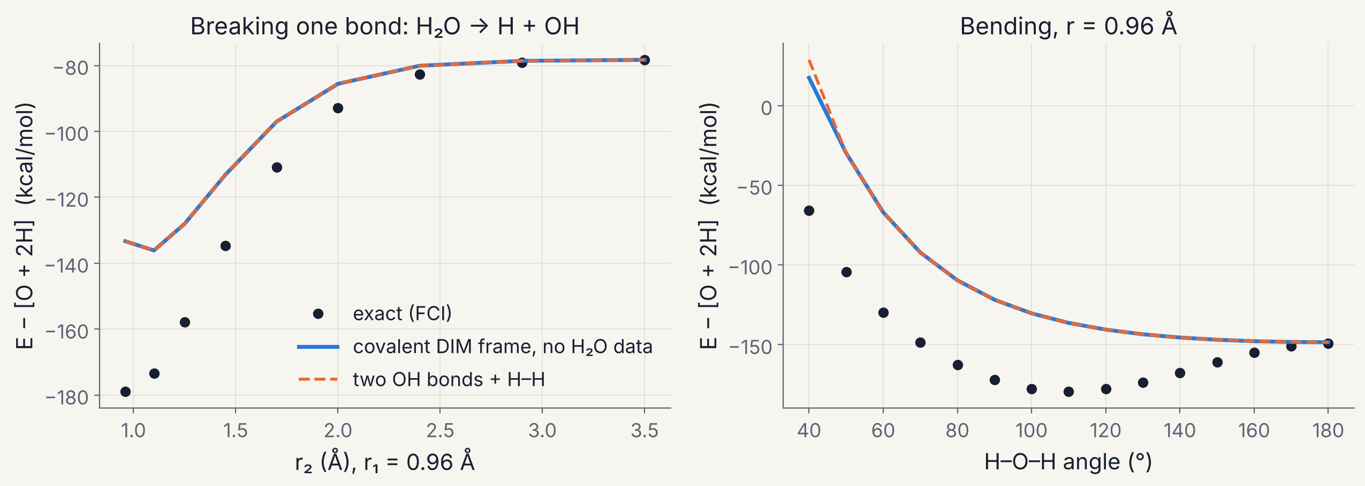
Water: a frame must contain the right structures
OXYGEN · WATER
TEST RMSE (KCAL/MOL)
Model | n = 40 | n = 80
Frame, no data | 24.8 | 24.8
+ OH state mixing | 20.8 | 17.6
+ kernel ridge | 13.1 | 4.7
Framed CDNN | 9.4 | 1.5
Kernel ridge alone | 32.0 | 5.1
Covalent DIM frame from eight OH states and H₂, with no water data: dissociation limits exact.
But 46 kcal/mol underbound and linear: two in-plane O 2p holes look like an OH bond from every direction.
Angle information requires ionic O⁻H⁺ structures.
Frozen-core FCI/6-31G, 149 geometries; mean of two random splits; DIM: F. O. Ellison, J. Am. Chem. Soc. 85, 3540 (1963)
19
Notes:
Covalent diatomics-in-molecules (Ellison 1963 applied DIM to water first): the basis is all O(2p^4) determinants times the spins of the two H atoms (60 states, 9 total singlets). Each OH state projector is built from three quantum numbers: O term (3P, 1D, 1S), |Lambda| along the bond and the O-H pair spin; H_DIM = H_OHa + H_OHb + H_HH - H_O - 2 H_H. It reproduces H + OH exactly and dissociation to O + 2H, but for every angle above about 60 degrees it equals bond additivity: with only O 2p orbitals, the two-hole configurations give an X2Pi bond along any in-plane direction. Earlier DIM work on water reached the same practical conclusion: O-H+ ionic structures and multicentre charge corrections are required. Learning: mixing OH states of different O terms (a fragment-level correction) barely helps, because the missing physics is outside the covalent space. A dense 9 x 9 correction inside the DIM frame, switched off when either H leaves, gets 1.5 kcal/mol from 80 points; kernel ridge on the same overlap features needs the same data to reach 5.1 and is at 32 with 40 points. The planned fix is an ionic DIM frame: O- + H+ structures, with OH- and H2+ fragment curves supplying their energies.

Slide 20
CH₂OO: charged and excited fragments fix the structures
TOWARD CRIEGEE INTERMEDIATES · FRAME
Structure | Dissociates to | Asymptote (source) | Long range
Covalent (×3) | CH₂O(S₀) + O(¹D) | 0 eV (reference) | constant
Biradical | CH₂O(T₁) + O(³P), singlet-coupled | +1.17 eV (CASSCF) | constant
Zwitterion H₂C=O⁺–O⁻ | CH₂O⁺ + O⁻ | IE − EA − ΔE(¹D) = 7.45 eV | −14.40 / r
10.88 − 1.46 − 1.97 eV: ionisation energy of CH₂O, electron affinity of O, O(¹D)–O(³P) splitting.
These are rungs of the ladder: the cation, the anion and an excited term.
r* ≈ 14.40 / 7.45 ≈ 1.9 Å
The ion pair crosses the covalent structures where the O–O bond breaks.
Experimental IE(CH₂O), EA(O) and O(¹D)–O(³P); ΔCCSD(T)/aug-cc-pVTZ check in diabml.refs.ladder
20
Notes:
The fragment-channel frame (diabml.frames.ChannelFrame) lists structures by the fragment states they dissociate to. For planar CH2OO breaking its O-O bond on singlet A' surfaces: O(1D) has three A' components (all degenerate at infinity: the three lowest asymptotes in our CASSCF data agree within 0.01 eV); the biradical channel is CH2O in its lowest triplet plus O(3P), singlet-coupled (the fourth state, +1.17 eV at 8 Angstrom); and the zwitterion H2C=O+-O- correlates diabatically with CH2O+ + O-. Its asymptote uses the ladder quantities: IE(CH2O) 10.88 eV, EA(O) 1.461 eV, O 1D-3P 1.967 eV (experimental values shown; diabml.refs.ladder computes IE and EA by delta-CCSD(T)/aug-cc-pVTZ; the term splitting is multireference and taken from experiment). Coulomb crossing radius r* = 14.40/7.45 = 1.93 Angstrom. The frame guarantees each diagonal element approaches its asymptote plus tail, and couplings vanish, for any weights. Charge-separation diabatisation of CH2OO (Samanta, Beames, Lester and Subotnik 2014) is the natural check on whether the learned ionic structure means what its label says.

Slide 21
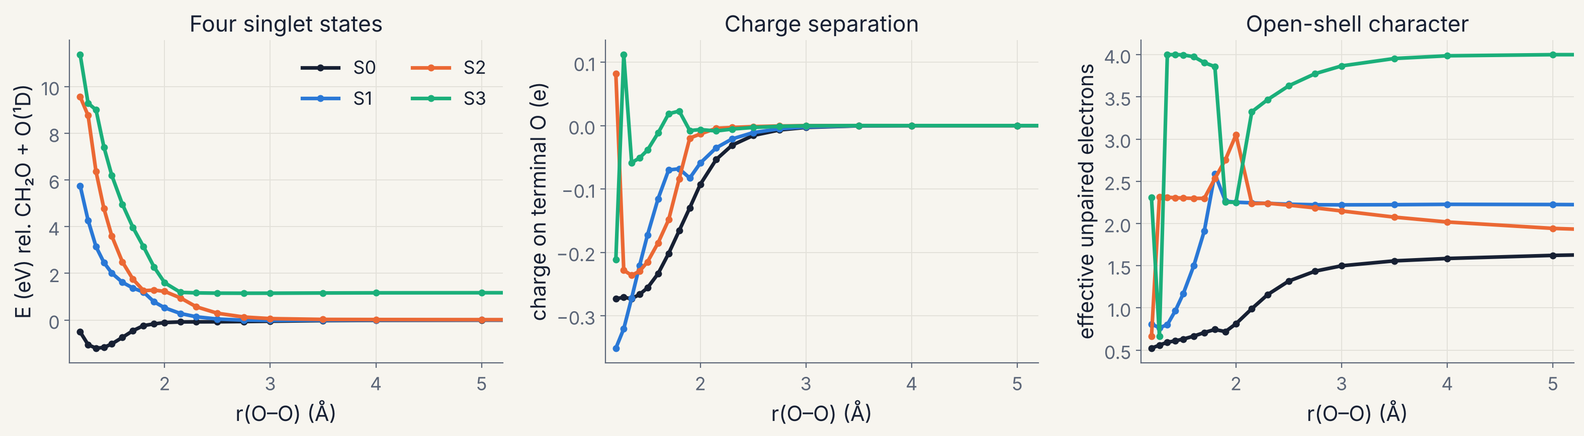
CH₂OO: part zwitterion, part biradical along O–O
TOWARD CRIEGEE INTERMEDIATES · REFERENCE DATA
Ground state at equilibrium: −0.27 e on the terminal O and 0.6 effective unpaired electrons; both change through 1.5–2.5 Å.
Data: SA4-CASSCF(8,6)/6-31G*, four singlet A′ states, 120 planar geometries. A methods testbed: no dynamic correlation, so the O–O bond is underbound.
PySCF SA4-CASSCF(8,6)/6-31G*; C–O–O angle 117.7° shown; per-state Mulliken charges and natural occupations
21
Notes:
Active space (8 electrons in 6 orbitals): the three pi orbitals of C-O-O, the O-O sigma and sigma-star, and the in-plane lone pair of the terminal O, enough to describe O-O cleavage to CH2O + O(1D) and the biradical channel. State-averaged over four roots, singlets enforced, Cs symmetry. Grid: r(O-O) 1.20 to 8.0 Angstrom (20 values) times angle C-O-O 65 to 155 degrees (6 values), CH2O held rigid. The scan driver visits geometries in nearest-neighbour order and starts each calculation from the projected orbitals of the closest finished point; all 120 converged with a consistent active space. Diagnostics per state from its own density: Mulliken charge on the terminal O (charge separation, a zwitterion proxy) and effective unpaired electrons sum min(n, 2-n) over natural occupations (biradical character). The jumps in S2 and S3 at short range are root reorderings. Quantitative CH2OO energetics need dynamic correlation (XMS-CASPT2, MRCI) and relaxed geometries; the binding here is far too weak, which is acceptable for testing whether a model handles the multistate structure.

Slide 22
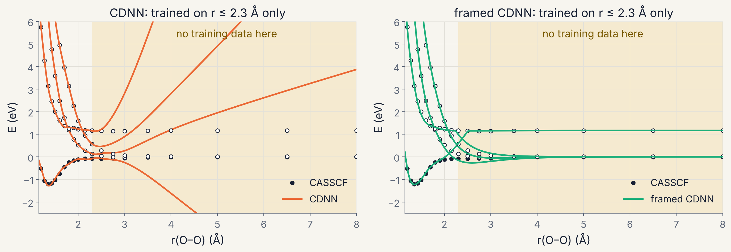
Physics where the data run out
TOWARD CRIEGEE INTERMEDIATES · EXTRAPOLATION
Beyond the training data (r > 2.3 Å): framed CDNN 2.2–6.4 kcal/mol across the four states; plain CDNN 110–330.
The cost: inside the data, plain CDNN fits the two lowest states somewhat better (1.1–1.6 against 3.2–3.6 kcal/mol).
Mean of three random training sets drawn from r ≤ 2.3 Å; SA4-CASSCF(8,6)/6-31G* references
22
Notes:
A realistic data situation: trajectories or sampling rarely reach full dissociation, so the long-range part of the surface is underrepresented. Both models get the same data: geometries with r(O-O) up to 2.3 Angstrom at all six C-O-O angles, 80 percent for training and 20 percent for validation, three random draws. The frame knows the asymptotes (from the large-r CASSCF states and the ladder), the Coulomb tail of the ion pair, and that all corrections and couplings must die off; the network learns only the short-range shape. A lesson from building it: the first version used a smooth switch that stayed near 1 out to 3 Angstrom, and the network extrapolated freely between 2.3 Angstrom and the switch. Replacing it with an orbital-overlap envelope and network inputs that saturate at long range (overlaps of r rather than r itself) fixed it: the same descriptor lesson as the first exploratory notebook. When the training data cover the full range (random split over all 120 points) the framed model reaches 1.6-4.2 kcal/mol test RMSE.

Slide 23
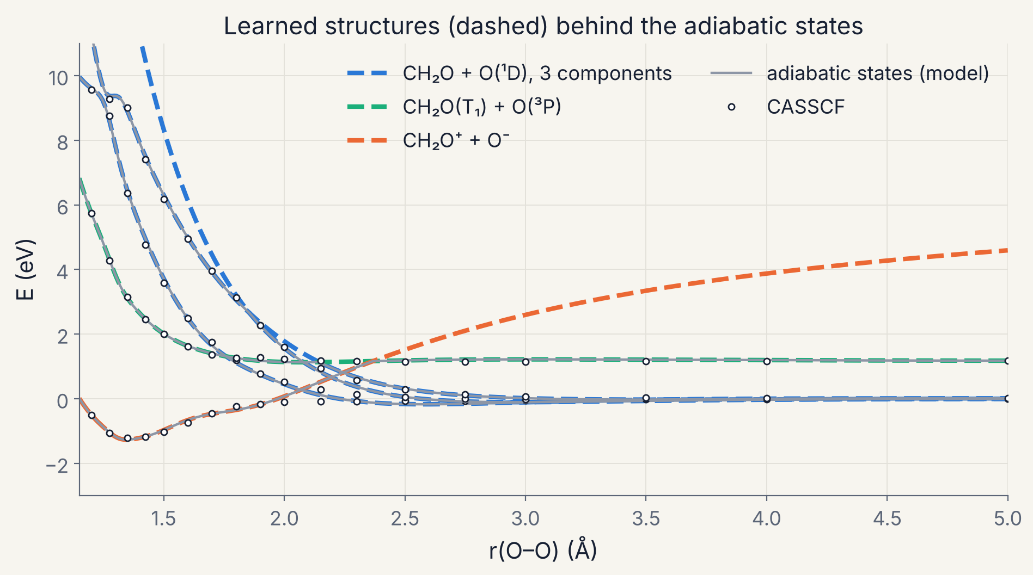
What the learned structures say, and what they do not
TOWARD CRIEGEE INTERMEDIATES · INTERPRETATION
Consistent: the equilibrium ground state is assigned to the zwitterion, which hands over to the covalent structures near 2.2 Å, close to the Coulomb estimate r* ≈ 1.9 Å.
Not yet diabatic: learned couplings are nearly zero, so the matrix stays close to adiabatic. Energies alone do not determine how much the structures mix.
Next: tie the ionic structure to the computed charge on the terminal O (a diabatic restraint).
Framed CDNN, random 90-point training split; diagonal elements of Ω at C–O–O = 117.7°
23
Notes:
This slide is a hypothesis, not a result. The framed model (trained on a random 90-point split, all r) has diagonal elements that follow the adiabatic states closely: the ionic structure carries the ground state at short range and crosses the covalent structures near 2.2 Angstrom, where the computed ground-state charge on the terminal O is also vanishing (slide 21). That is chemically sensible: the zwitterionic resonance form dominates the Criegee intermediate's ground state near equilibrium. But the off-diagonal couplings came out small, so the model's ground state is close to 100 percent ionic at equilibrium, while the CASSCF charge (-0.27 e) and 0.6 unpaired electrons say it is a mixture. This is exactly the CDNN point: many compatible matrices give the same eigenvalues, and energies alone do not select the diabatic one. The fix is information beyond energies: a restraint linking the ionic population of each eigenvector to the computed charge separation (in the spirit of Shu and Truhlar's DDNN diabatic restraints, and Samanta et al.'s charge-separation diabatisation of CH2OO). diabml already stores per-state charges and unpaired-electron counts for this.

Slide 24
diabml: a Python backend for exploring frames
SOFTWARE
refs · FCI, SA-CASSCF scans, ladder fragments
Adding a physics frame
RefSet · one cached file per data set
class MyFrame(Frame):
n_diabats = 3
slots = {'coupling': (n_in, n_out)}
def prepare(self, coords):
# fixed, parameter-free tensors
return {..., 'slot_in': {...}}
def assemble(self, cache, out):
# differentiable in out
return Omega # (N, 3, 3)
model = FramedModel(MyFrame(), n_states=2)
frames · London, DIM water, fragment channel
models · CDNN, framed CDNN, baselines, training
metrics · plotting · ui · and three notebooks
Tests check each frame’s guarantees with random weights: exact degeneracies, permutation invariance, dissociation limits.
NumPy, SciPy, PyTorch, Matplotlib; PySCF (Sun et al., J. Chem. Phys. 153, 024109, 2020) for reference data
24
Notes:
Layout of the code base (Python; NumPy, SciPy, PyTorch, Matplotlib; PySCF only to make new reference data). refs: FCI for small systems, frozen-core FCI with symmetry labelling for OH states, an SA-CASSCF scan driver with orbital continuity and per-state charge and unpaired-electron diagnostics, and ladder fragment calculations (delta-CCSD(T) IE and EA). RefSet: coordinates, multistate energies, diagnostics and metadata in one .npz, so notebooks need no quantum chemistry installed. frames: the Frame interface plus LondonFrame, DIMWaterFrame and ChannelFrame. models: CDNN as in the paper, the independent-surface control, FramedModel (zero-initialised slot networks), kernel ridge, one shared training loop with restarts and validation checkpointing, and permutation augmentation. Notebooks: 01 H3 (London frame vs CDNN, symmetry metrics, interactive cut explorer), 02 H2O (DIM frame, learning curves), 03 CH2OO (state character, ladder anchors, interpolation and extrapolation tests, learned structures). A pytest suite (11 tests) checks the frames' guarantees with randomly initialised networks.

Slide 25
Next steps
OUTLOOK
IONIC FRAME FOR WATER
DIABATIC RESTRAINTS
CH₂OO IN FULL
O⁻ + H⁺ structures with OH⁻ and H₂⁺ fragment curves: does the bend appear with no water data?
Tie structures to computed charges and spins, moving from compatible toward diabatic matrices.
All internal coordinates, the dioxirane channel and triplets, with XMS-CASPT2 or MRCI references.
O₃ BENCHMARK
DYNAMICS
SCALING
The six-state data set of Shu et al., with an O₂ + O fragment frame against plain CDNN.
Curvature-driven surface hopping needs only energies and gradients, which the matrix provides.
Matrix size follows the number of chemically relevant structures, not the number of electrons.
25
Notes:
Priorities, roughly in order of cost. (1) Ionic DIM for water is the decisive test of the claim that the frame's structures, not more data, are what water was missing; it needs OH- states and the H2+ curve at the same level, the electron ladder in fragment form. (2) Diabatic restraints: add a loss term tying the ionic population of eigenvectors to computed charge separation (the per-state diagnostics already stored by the CASSCF driver), the DDNN idea of Shu and Truhlar (2020). (3) CH2OO in more coordinates; the channel frame only needs the O-O distance for its envelope, so other coordinates enter as network inputs. (4) O3: the paper's 11,249-geometry six-state XMS-CASPT2 data set is the natural benchmark for a fragment frame built from O2 states plus O(3P/1D). (5) Dynamics: curvature-driven coherent switching and trajectory surface hopping (Shu et al. 2022) need adiabatic energies and gradients only; a matrix model supplies both, with correct crossing topology; this also returns to the hot-Criegee MD and IR goals of the earlier work. (6) Scaling argument: the cost is set by local evaluation of matrix elements (roughly linear in atoms) and by diagonalising a small or block-sparse matrix of chemically relevant structures.

Slide 26
Conclusions
SUMMARY
The middle zone needs a multistate description. Avoided crossings, ion-pair structures and spin recoupling defeat single-surface fits, as our earlier hot-Criegee surfaces showed.
Learning a matrix and diagonalising it (CDNN) gives conical intersections and avoided crossings the correct local topology from energies alone.
Building the matrix from fragment states makes symmetry and dissociation limits exact for any weights. H₃: 1.7 kcal/mol from 25 points with exact degeneracy at D₃h.
The frame must contain the right structures. Water: covalent DIM is linear; a correction inside it reaches 1.5 kcal/mol from 80 points, and the gap points to ionic structures.
The electron ladder selects those structures: charged and excited fragments set the asymptotes. CH₂OO: extrapolation errors drop from 110–330 to 2–6 kcal/mol.
Open problem: energies alone do not make the learned matrix diabatic; charge or spin restraints are needed.
26
Notes:
Summary. CDNN (Shu et al. 2025) solves the topology problem of fitting coupled surfaces: a smooth learned matrix, diagonalised, has the right conical intersections and avoided crossings, and needs only energies. A physics frame solves what a generic network cannot guarantee: which structures span the matrix, how its elements transform, and its limits; zero-initialised corrections then learn only what the physics misses. H3: ground-state accuracy near 1 kcal/mol from tens of points with exact symmetry. H2O: a covalent frame is not enough; a learned correction inside it reaches 1.5 kcal/mol from 80 points, and the missing ionic structures say what to add. CH2OO: a minimal frame from fragment and ladder data turns extrapolation errors of hundreds of kcal/mol into a few. The open problem is making the learned matrix diabatic, which needs information beyond energies.

Slide 27
Diabatic states and learned matrices (Truhlar and co-workers)
REFERENCES
C. A. Mead, D. G. Truhlar, J. Chem. Phys. 77, 6090 (1982). Strictly diabatic states.
Z. Varga, Y. Shu, J. Ning, D. G. Truhlar, Electron. Struct. 4, 047002 (2022). 14 ³A′ states of O₃.
K. A. Hoyer, S. M. Parker, L. Gagliardi, D. G. Truhlar, J. Chem. Phys. 144, 194101 (2016). DQΦ.
F. B. Akher, Y. Shu, Z. Varga, D. G. Truhlar, J. Chem. Theory Comput. 19, 4389 (2023). Six ⁵A′ states of O + O₂.
Z. Varga, K. A. Parker, D. G. Truhlar, Phys. Chem. Chem. Phys. 20, 26643 (2018). N/D method.
Y. Shu, Z. Varga, A. M. Parameswaran, D. G. Truhlar, J. Chem. Theory Comput. 20, 7042 (2024). Companion matrices.
Y. Shu, D. G. Truhlar, J. Chem. Theory Comput. 16, 6456 (2020). DDNN.
Y. Shu, Z. Varga, A. G. S. de Oliveira-Filho, D. G. Truhlar, J. Chem. Theory Comput. 17, 1106 (2021). Permutational restraints.
Y. Shu, L. Zhang, X. Chen, S. Sun, Y. Huang, D. G. Truhlar, J. Chem. Theory Comput. 18, 1320 (2022). Curvature-driven surface hopping.
F. B. Akher, Y. Shu, Z. Varga, S. Bhaumik, D. G. Truhlar, J. Phys. Chem. A 127, 5287 (2023). PM-DDNN.
Y. Shu, D. G. Truhlar, J. Chem. Theory Comput. 20, 4396 (2024). Curvature-driven Ehrenfest dynamics.
Y. Shu, Z. Varga, S. Kanchanakungwankul, L. Zhang, D. G. Truhlar, J. Phys. Chem. A 126, 992 (2022). Review.
Y. Shu, Z. Varga, D. Zhang, Q. Meng, A. M. Parameswaran, J.-G. Zhou, D. G. Truhlar, J. Chem. Theory Comput. 21, 3342 (2025). CDNN.
27
Notes:
The line of work summarised on slide 3. For students the 2022 J. Phys. Chem. A review is the most accessible entry to diabatic states and why they matter for photochemistry; Mead and Truhlar 1982 is the classic argument that strictly diabatic states do not exist in general. Author lists are as given in the CDNN paper's reference list.

Slide 28
Valence-bond physics and machine-learned potentials
REFERENCES
W. Heitler, F. London, Z. Phys. 44, 455 (1927). The H₂ bond.
Z. Yin, B. J. Braams, B. Fu, D. H. Zhang, J. Chem. Theory Comput. 17, 1678 (2021). VB-based symmetry-adapted networks, H₃⁺.
F. London, Z. Elektrochem. 35, 552 (1929). The London equation.
J. von Neumann, E. Wigner, Phys. Z. 30, 467 (1929). Noncrossing rule.
A. E. A. Allen, G. Csányi, J. Chem. Phys. 160, 124108 (2024). Transferable EVB.
H. Eyring, M. Polanyi, Z. Phys. Chem. B 12, 279 (1931). First reaction surface.
Š. Sršeň, O. A. von Lilienfeld, P. Slavíček, Phys. Chem. Chem. Phys. 26 (2024), doi 10.1039/D3CP05685F.
C. Zener, Proc. R. Soc. A 137, 696 (1932). Avoided-crossing transitions.
J. Behler, M. Parrinello, Phys. Rev. Lett. 98, 146401 (2007). Neural-network potentials.
S. Sato, J. Chem. Phys. 23, 592 (1955). LEPS surfaces.
S. Batzner et al., Nat. Commun. 13, 2453 (2022). NequIP. I. Batatia et al., NeurIPS 35 (2022). MACE.
F. O. Ellison, J. Am. Chem. Soc. 85, 3540 (1963). Diatomics in molecules.
A. Warshel, R. M. Weiss, J. Am. Chem. Soc. 102, 6218 (1980). Empirical valence bond.
D. Hendrycks, K. Gimpel, arXiv:1606.08415 (2016). GELU. D. P. Kingma, J. Ba, arXiv:1412.6980 (2014). Adam.
28
Notes:
Classic valence-bond and surface-crossing physics on the left; machine-learning context on the right. Behler-Parrinello is the origin of atom-centred neural-network potentials; NequIP and MACE are the current equivariant message-passing standard for single surfaces.

Slide 29
Criegee intermediates, previous work and software
REFERENCES
O. Welz et al., Science 335, 204 (2012). Direct detection of CH₂OO.
T. A. Stephenson, M. I. Lester, Int. Rev. Phys. Chem. 39, 1 (2020). Criegee intermediate spectroscopy and dynamics.
J. M. Beames, F. Liu, L. Lu, M. I. Lester, J. Am. Chem. Soc. 134, 20045 (2012). UV spectrum of CH₂OO.
C.-A. Chung, Y.-P. Lee, Commun. Chem. 4, 8 (2021). Step-scan FTIR of MVKO.
K. Samanta, J. M. Beames, M. I. Lester, J. E. Subotnik, J. Chem. Phys. 141, 134303 (2014). Charge-separation diabatisation.
B. Simiyu, J. M. Smith, ACS Fall Meeting 2025 (poster). Machine-learned potential energy surfaces for hot Criegee intermediates. laserchemist.github.io/MD_MLPES/talk
M. I. Lester, S. J. Klippenstein, Acc. Chem. Res. 51, 978 (2018). Unimolecular decay of Criegee intermediates.
Q. Sun et al., J. Chem. Phys. 153, 024109 (2020). PySCF, used for all reference data here.
29
Notes:
Criegee background: Welz et al. made the first direct kinetic measurements of CH2OO; Beames et al. measured its strong UV absorption, which dissociates the O-O bond; Samanta et al. built quasi-diabatic states for that photodissociation by maximising charge separation, the natural comparison for the learned zwitterion structure here; Lester and Klippenstein review how energized Criegee intermediates decay to OH. Chung and Lee provide the MVKO infrared spectrum used to test the earlier ML surfaces. All reference calculations in this talk used PySCF.

